Slide 1

Bank Campaigns Data Analysis

Slide 2

Agenda
Introduction
Results of our campaign
Summary

Slide 3
Introduction
Our data is related with direct marketing campaigns of a Portuguese banking institution.
The marketing campaign were based on phone calls.
Often, more than one contact to the same client was required.
If the product (bank term deposit) would be ('yes') or not ('no') subscribed.

Slide 4
Results of this Campaign
Let’s dive in

Slide 5
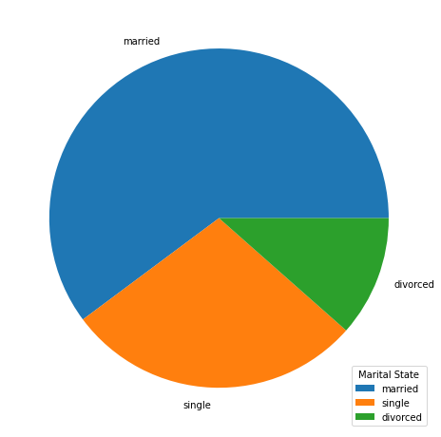
Clients Marital state
Number of married/unmarried clients
Marital State | Count
Married | 27214
Single | 12790
Divorced | 5207

Slide 6
Clients Marital state cont.
 | Married | Single | Divorced
Count | 60.2% | 28.3% | 11.5%
Subscribed to our product | 52.1% | 36.2% | 11.7%
Had Housing Loan | 70% | 27% | 11.5%
Had general Loan | 64% | 23% | 12.7%

Slide 7
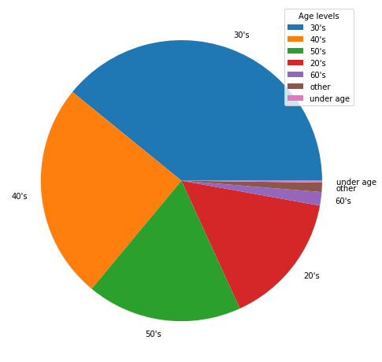
Ages of Our Clients
Age Level | Percentage
30's | 39.12%
40's | 24.85%
50's | 17.84%
20's | 15.33%
60's | 1.55%
other | 1.07%
under age | 0.214%

Slide 8
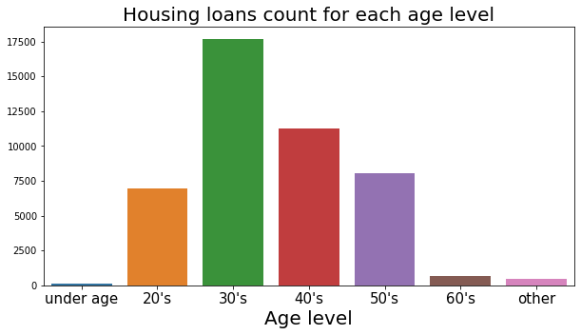
Ages of Our Clients cont.

Slide 9
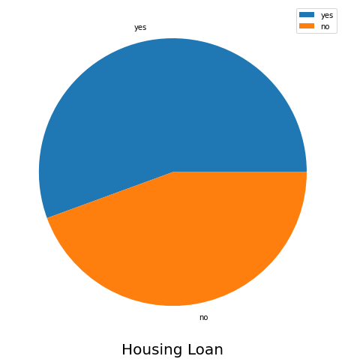
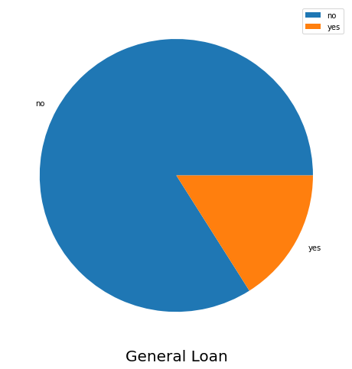
Number of clients who had loans before
Observation:
55.58% of our clients have had a housing loan before, while only 16% of our clients have had a general loan.

Slide 10
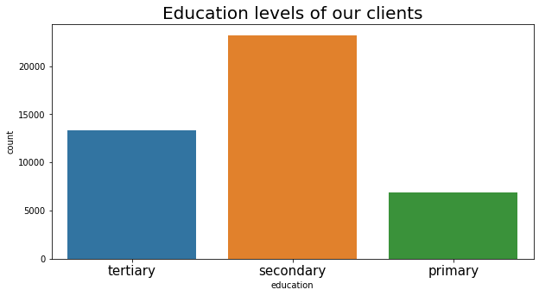
Education Levels of our clients
Education | Percentage
Secondary | 51.32%
Tertiary | 29.42%
Primary | 15.15%

Slide 11
Outcomes of this campaign
Which contact communication type was used the most with the people who had subscribed?
82.6% of the clients were contacted by Cellular.
Which season had the most subscriptions?
Summer was the highest by percentage of 33.1%
which month have the bank made the most subscriptions?
While Winter was had the least subscriptions by percentage of 12.9%
May had the most subscriptions by percentage of 17.5%
While December had the least subscriptions of 1.8%
How many clients have credit cards?
Most of our clients have no credit cards.
Only 1% of are clients have credit cards

Slide 12
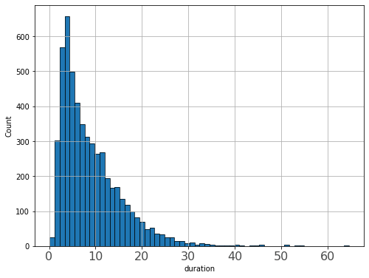
Outcomes of this campaign cont.
Does calling the client multiple times affect
their decision?
Does the duration of the call affect the
client's decision?
Doesn’t affect the decision of the client directly as calling the client for one time have the largest percentage of approximately 50%
Most of the clients who have subscribed talked with our employees for 1 to 10 min.
Number of calls | Percentage
1 | 48.42%
2 | 26.48%
3 | 11.68%
4 | 5.99%
Above 4 calls | 7.411%

Slide 13
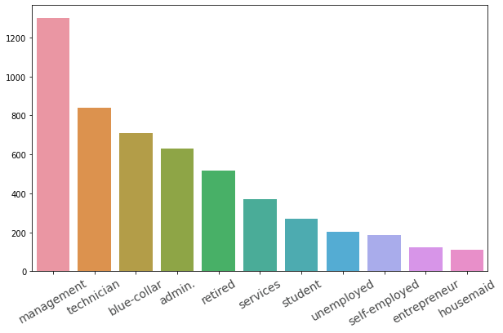
Outcomes of this campaign cont.
What is the most frequent job title?

Slide 14
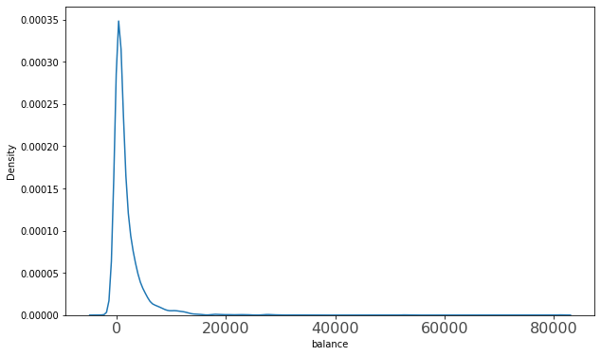
Outcomes of this campaign cont.
what was the balance of our clients when
they subscribed?
The balance of our clients who have subscribed was from -3058 minimum to 81204 maximum

Slide 15
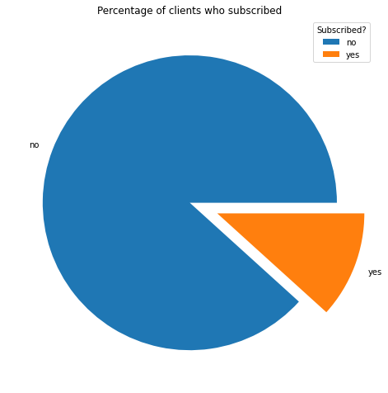
Outcomes of this campaign cont.
How many clients have subscribed to the product of this campaign?
Only 5289 clients have subscribed to this product of percentage 11.7%

Slide 16
Summary
We should target:
Married clients as they are most likely to take loans.
Clients that are in their 30’s or 40’s.
Clients who have already taken loans before.
We should:
Convince our clients within 10 minutes.
Try to communicate with our clients in different ways other than phone calls.
Promote for credit cards.

